Slide 1

NPS Survey Analysis
Hitesh Sanwal
R19DM002
REVA University, Bengaluru

Slide 2
Agenda
Introduction
Challenges
Problem Statement & Objectives
Data Gathering & Understanding
Data Preparation
Sentiment Analysis
Deployment
Analysis & Results
Conclusion & Future Recommendation

Slide 3
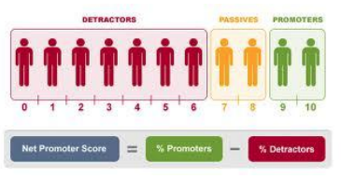
Introduction
Every business need money to survive and to make money one of the most important asset a businesses need is customers. Loyal customers are worth up to 10 times their initial purchase value. So, the big question is how to measure customer satisfaction?
In current times there are many metrics, however, since 2003, Net Promoter Score (by Fred Reichheld) stood out as one of the key metric to measure customer satisfaction and is still a widely used metric.
How to Calculate the NPS Score?
A simple rating question: How likely are you to recommend [Company Brand] service/product/brand to your colleague, friends or family on a scale on 0 to 10 (where 10 is extremely likely)? does the job.
Based on the rating given by the customers, three bins are created:
Promoters (Score 9 – 10): These are very happy by the services provided by the company and will always speak good about the business and will bring more customers due to positive recommendations.
Passively Satisfied or Neutrals (Score 7 -8): Those who score 7 or 8 are okay with the services and may or may not switch to other competitors.
Detractors (Score 0-6): They are the customers who had a bad experience and can possibly churn. They are the ones who are likely to damage the brand by bad reviews.
% of promoters - % of detractors gives the NPS score which is used as a measure of customer satisfaction and future growth potential of the business.

Slide 4
Challenges
Across many industries net promoter score is now used as a key KPI for every department. However, it is key to understand that there is more to an NPS survey than the score itself. There are various elements of the NPS data that will help us collect in-depth customer insights which very easily are missed, but nevertheless, very important for an effective NPS analysis. The key aspects to invest time and effort are:
Understand the Net Promoter Score Analysis
Take a Closer Look at Your NPS Distribution
Find which survey channels work best
Focus on Customer Engagement
Feedback Sentiment Analysis
Take Feedback Analysis Seriously, and Act on It
Different elements considered as part of the study are:
More Fields: Use of an open end and other questions which capture more information from the client, not just the NPS question.
No Analysis capability: A lot of Data collection companies allow ways to capture the NPS data by providing effective survey building technology but do not add any analysis element to the data collected.
Not much use of ML: Not effectively using the ML techniques to enhance the value of analysis.

Slide 5
Problem Statement & Objectives
The Key Points are:
A Software-as-a-Service (SaaS) company which currently provides survey products that enable Market Researchers, CX specialists collect customer feedback wants to add the flavor of Data Analytics into its toolkit of features.
Data is collected for a variety of different surveys; company want to start the analysis process by analyzing one key survey for a Company XYZ which collects NPS and CES score data through a web-based survey created through the platform. The company wants to provide key actionable insights, which are easy to understand after the thorough analysis of the collected survey data via a dashboard.
The default dashboard will be provided for each survey created through the platform and will serve as a baseline to promote the scope for a bespoke more quality dashboard that can provide more advanced analytics features that the clients can use to drive their business.
The overall anticipated outcome is :
Actionable Insights: Thorough analysis on collected data to make recommendation to the business if the existing approach is good enough and how interactive dashboards can help all members of the team to understand the raw collected data with ease, so it enables them to act and make improvements to the survey to further collect key features which can be helpful in making more powerful business decisions.
More Revenue: once clients realize the platform can offer great analytics and like the default dashboards, they will request for bespoke use cases which will result in expanding the analytics side of the business, in turn, would lead to more revenue.
More Options: Company can suggest more better approaches than NPS to gauge customer loyalty by scoping it as additional project.

Slide 6
Business Understanding
What are the business objectives?
The company wants to add the feature of data analysis in its features toolkit to increase its product offering to its customers.
Initially, the plan is to provide some free key insights on the data collected in the survey platform and later use different marketing channels to make the customer aware the company can do much more to meet their customers' analysis requirement.
In turn, would lead to a bigger scope for the projects as analysis will also be part of the offering and features of advance analytics will be part of bespoke offerings.
What is the data analysis goals?
The analysis goals for this project were focused on one survey. For the data collected for this survey, key insights were to be analyzed with the help of data science techniques and present those insights utilizing a dashboard so that the client can make actionable decisions.
If the analysis is liked by the client and they decide to use it, the sales team will pitch the budget for enhancing the dashboard to make it as real-time such that every new data collected will be available for the team in the dashboard.

Slide 7
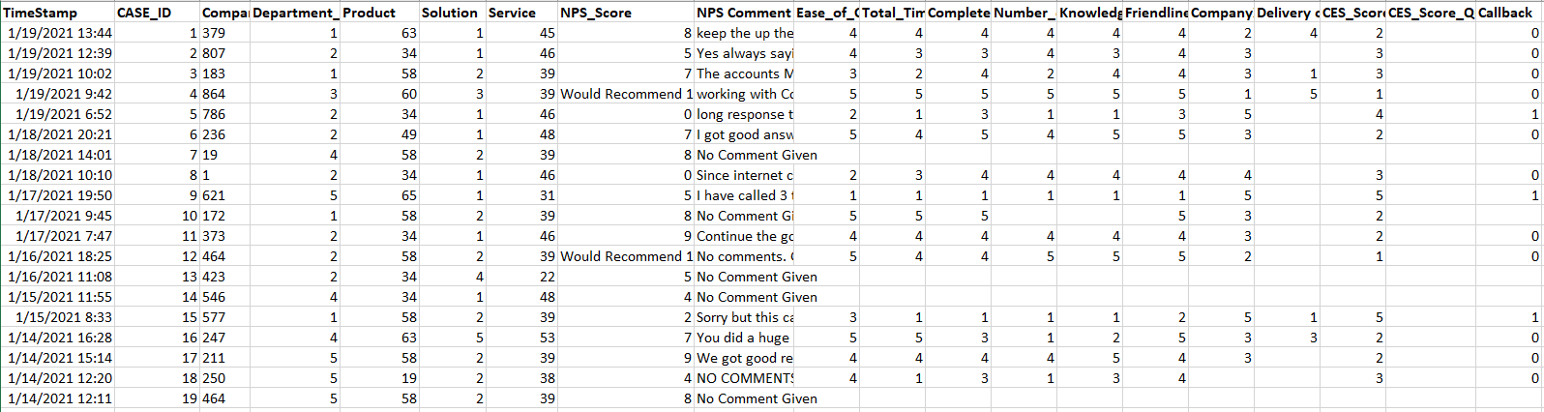
Data Gathering & Understanding
Initial Data Collection:
Data is collected daily using a MWeb survey. The survey platform enables its client, CompanyXYZ to send email invitations daily at different time intervals with a web survey link.
Survey targets all those customers who interacted with key touchpoints for different services offered like Internet services, Network Equipment’s, Customer Support, Logistics, and Billing. The survey link enables the participants to answer a short, branded questionnaire that is not too long, focuses on capturing the experiences of the customer, uses NPS as one of the key metrics.
Describing The Data:
For this project data collected from Feb-2016 till Jan-2021 is used.
Dataset consisted of a total of 5698 records.
A total of 15 fields are present and each clearly understood(fig. below)
Signing Off The Data Quality:
A lot of users did not comment on NPS scores.
Partial completes were not considered and reported to the project team so they can monitor.
NPS Score had label and comment in some instances which need to be cleaned to have only the value.
Data quality was signed off for the next phase of analysis.

Slide 8
Data Preparation
Masking
New Fields Creation
Imputation
Binning
Features containing sensitive information were masked using Python
Year, Quarter & Month created from Date field
High Effort & Low Effort created from CES Score
A lot of participants did not provide comments. Such data was imputed with No comment as it will be good to understand what % of the users did not provide the feedback.
Based on the NPS score the participants were grouped into 3 buckets: Promoters (score 9-10), Neutrals (Score 7-8) , Detractors (Score 0-6) and calculate NPS Score for each month by calculating % of promoters and detractors

Slide 9
Data Preparation
To correlate the NPS sentiments with NPS Score we will have to use Sentiment Analysis.
Before running sentiment analysis on the comments, the following pre-processing steps were implemented by making use of NLTK:
Lowercasing
Removal of Punctuations
Spelling Correction
Stemming
Lemmatization
Stop word Removal

Slide 10
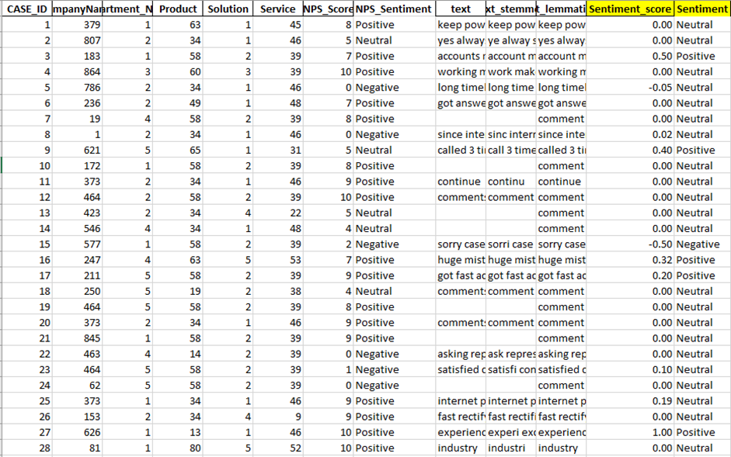
Sentiment Analysis
1.TextBlob (a python library) is used for checking sentiments of the NPS and CES comments. TextBlob returns polarity of a sentence.
2.The polarity lies between [-1,1]
3. In our use cases we classified the sentences based on the following rule:
with polarity greater than 0.2 as positive sentiments
less than -0.2 as negative and
in between -0.2 and 0.2 as neutral sentiments.
4.These sentiments were added to the data set by creating a new feature.
5. A correlation between the score given by sentiment analysis and NPS score gave us a very low co-relation.

Slide 11
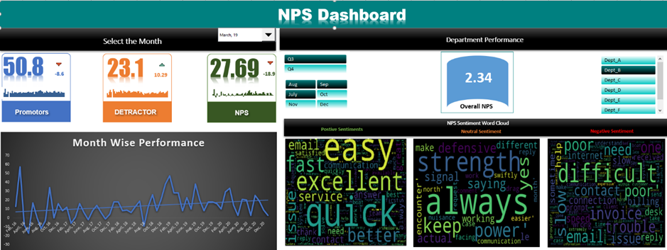
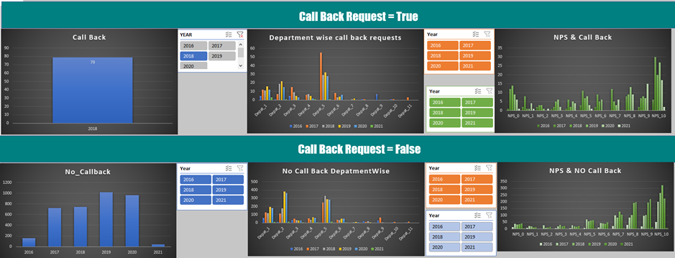
Deployment
The analysis dashboard and sentiment model results will be tested and monitored for 3-4 months and would require manual efforts to upload the daily data into the excel dashboard.
Once the business decides to invest the same rules can be deployed across different more advanced tools like Tableau etc.
The entire process will be automated by using automated data transfer to the dashboard tool via SFTP data upload or an API.
Below is the snapshot from the Excel Dashboard.

Slide 12
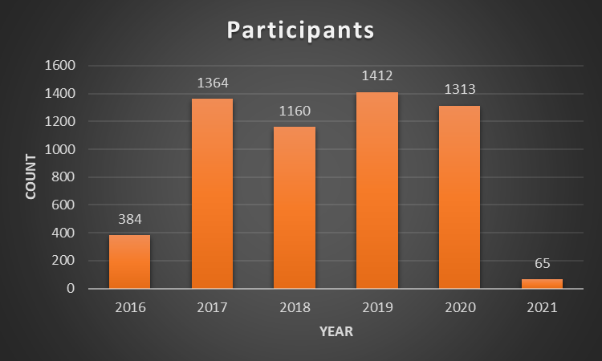
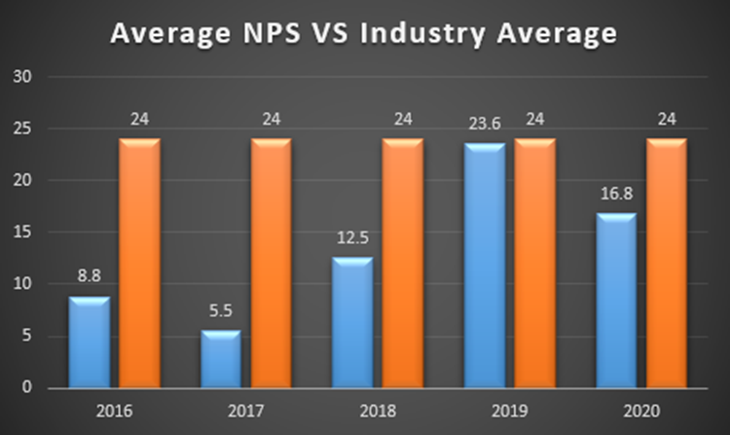
Analysis & Results
No. of Participants
NPS Score Trend
The pilot started in Feb 2016 the number of participants has been consistent, max being in 2019
The Average NPS Score showed an increasing trend from 2017 and was the highest in the year 2019 and it dropped in 2020. The industry has an average NPS Score of 24, telecom holds the lowest industry average according to the NPS Benchmarks Report 2018.

Slide 13
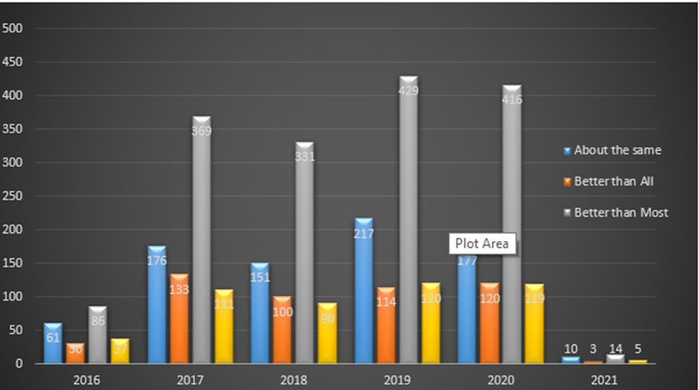
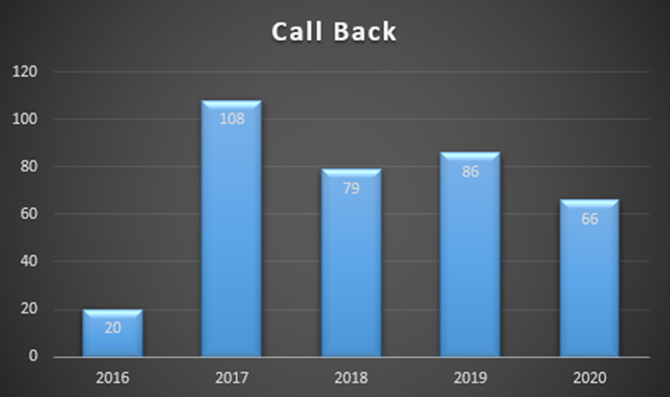
Analysis & Results
Brand Comparison
Call Back Trend
When it comes to comparing CompanyABC with other providers, the top 3 comparison from 2016 to 2020 are: Better than Most, About the same, Better than All.
Call back field was captured the participant willing to speak to Company Support staff. This question was kept as an additional measure to capture if any participant providing a bad score would like to share more details and the support staff can provide more TLC to make sure the client does not become a detractor.
The number of call back showed a decreasing trend

Slide 14
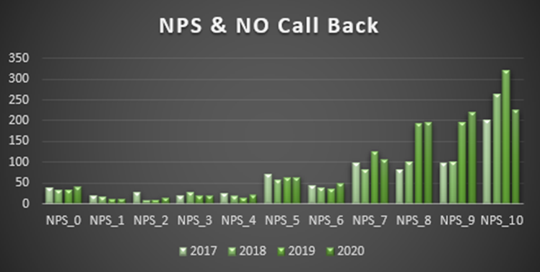
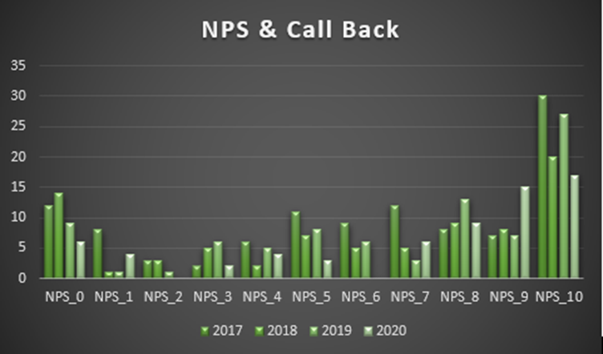
Analysis & Results
NPS & CallBack
NPS & CallBack
The general understanding was that participants providing a good NPS Score (9 & 10) will not be requesting for call backs, however, the analysis showed the high call back requests were given by participants giving 9 and 10 NPS score.
This becomes very critical for the business to monitor these support calls to understand why the call back is requested and in case any dissatisfaction is shared it is acted upon immediately so that these promoters do not become passives or Detractors.
Participants who did not request the call backs the results were in line with the general understanding, participants giving high NPS Score were did not request for call back.

Slide 15
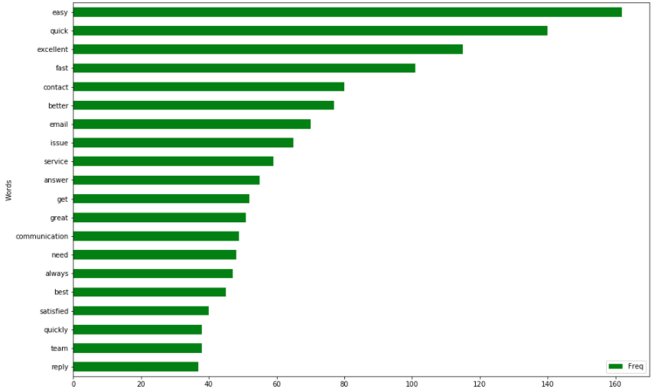
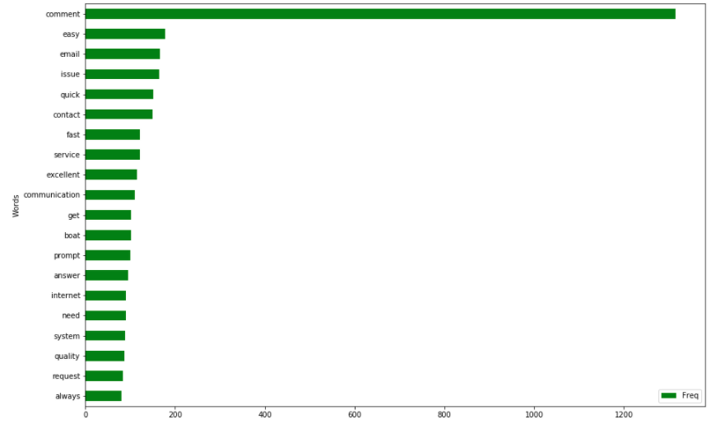
Analysis & Results
Word Frequency Sentiment Analysis Word Frequency NPS Sentiment
The sentiments generated by the Sentiment Analysis model gave a far better frequency of the words most used words in comments via word cloud.
The graphs shows the top twenty words for positive NPS sentiment via creating word cloud from direct comments and from Comments after running sentiment analysis.

Slide 16
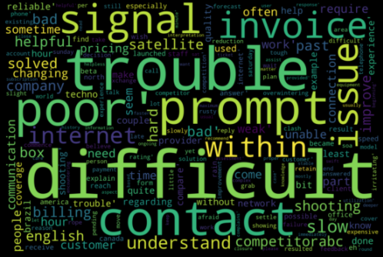
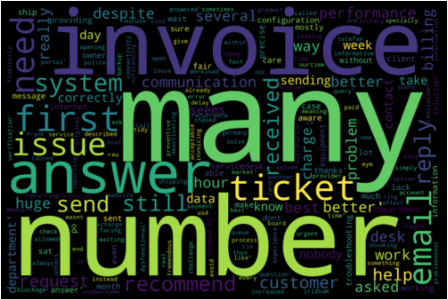
Analysis & Results
Analyzing Mis Match:
One of the big highlights was that a basic sentiment analysis gave far better keywords in the word cloud for NPS comments. To check it further wordcloud were created for two cases:
Sentiment Score Negative VS NPS Score Positive
Sentiment Score Positive VS NPS Score Negative

Slide 17
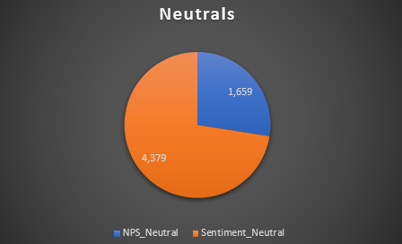
Analysis & Results
MisMatch:Neutrals
One of the main drawbacks of NPS Score is the neutrals. Neutrals are not part of the NPS Score overall calculation. Sentiment analysis on dataset shows the neutrals are far higher than what are being reported by NPS Comments. This raises a key point should the analysis be just done by considering NPS Score?

Slide 18
Conclusion and Future Work Recommendations :
Conclusion:
Dashboard designed here will support the team (Project managers, support staff, senior management etc.) to get a quick overview of how participants of the survey have shared their experience and help them in taking quick action to support the customers better and keep them engaged with the company for a longer duration.
The Dashboard also provides Sentiment analysis for the NPS and CES comments which allows the team to easily understand the emotions of the participants and narrow down if the NPS Score is really a good predictor for customer retention.
Wordcloud helps in providing a good essence about the emotions and verbs used in the comments.
With the help of lot of filters, it becomes easy for the team to pinpoint a particular area they want to monitor.
Future Recommendations:
Scale the size of the project and make automation the backbone for each the task required to generate the Dashboard like:
Data export for the surveys, Data transfer/upload to the Dashboard. Alerts notification based to ensure any issues with the dashboard are notified to the respective teams.
Use more advanced Data Science tool to add value to the analysis. Automated recommendations to the clients so they can get an understanding if they need to make changes to the type of surveys and metrices they are capturing.
To have some sort of Data purging settings so that the Dashboard can show the latest Data and old Data is archived effectively for performance enhancement
As we saw a simple Sentiment analysis is giving far better results in gaining insights on the key emotions, we should push the client to adopt more of ML as part of analysis and this opens big scope for more money and bigger SOW’s

Slide 19
References
Alex. (2019). NPS Data Analysis and Reporting.
Frederick F. Reichheld. (2003). the-one-number-you-need-to-grow.
Jared M. Spool. (2017, December). Net Promoter Score Considered Harmful (and What UX Professionals Can Do About It).
Katerina Sinitskaia. (n.d.). Telecommunications NPS Benchmarks And CX Trends.
M.W. Krol, D. de Boer, D. Delnoij, J.J.D.J.M, & Rademakers. (2015). The Net Promoter Score: An asset to patient experience surveys?
Muhammad Farooq, Valliappan Raju, Faisal Khalil-Ur-Rehman, 4Waqar Younas, 5Qazi Mohammed Ahmed, & Muhammad Ali. (n.d.). Investigating Relationship between Net Promoter Score and Company Performance: A Longitudinal Study .
Timothy L. Keiningham, Bruce Cooil, Tor Wallin Andreassen, Lerzan Aksoy, & Timothy L. Keiningham. (2008). A Holistic Examination of Net Promoter.

Slide 20
Thank You!

